Slide 1


TELCO
Customer data analysis and churn prediction
PRESENTED BY
GROUP 13
Yash Tyagi Abhinav Sharma

Slide 2


Table of Contents
What is our Information product?
Problem Statement Porter's five forces anlaysis
Data Set
Data Wrangling Descriptive Analysis
Visualization
Insights & Key Take Aways

Slide 3




What is Our Information Product?
TELCO
Our IP is a Tool to predict Customer churn for the company Telco Systems
Analysis of Predicted Customer Churn data
Customer churn is when customers stop doing business with a company. Predicting churn helps prevent customer loss and increase revenue

Slide 4


TELCO
Case Study
Today, we will examine a case involving the well-known telecommunications company TELCO.
We have gathered our datasets for TELCO from open sources such as KEGG and will use them to study and comprehend the use of these datasets and overall effect of Churn

Slide 5
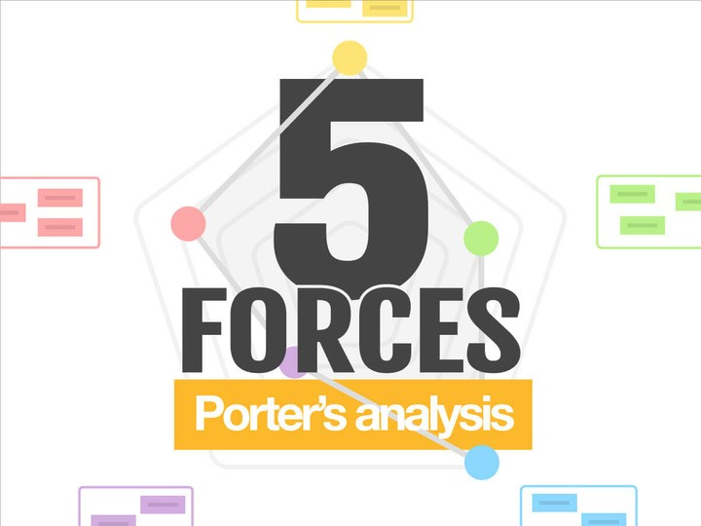

We are focusing heavily on the two forces given below:
Threat of new entrants: The telecommunications industry is highly regulated and requires significant investments in infrastructure, which makes it difficult for new entrants to compete with established players like Telco. However, with the advancement in technology, new players can enter the market with low-cost solutions, making the industry even more competitive.
Competitors: AT&T, Verizon,T-Mobile, Sprint.
2) Bargaining power of buyers: Buyers in the telecommunications industry have significant bargaining power due to the high competition and the low switching costs.
3) Intensity of competitive rivalry: The telecommunications industry is highly competitive, with several established players and new entrants vying for market share. To stay ahead in the market we
need to use data analysis to retain the customers.

Slide 6



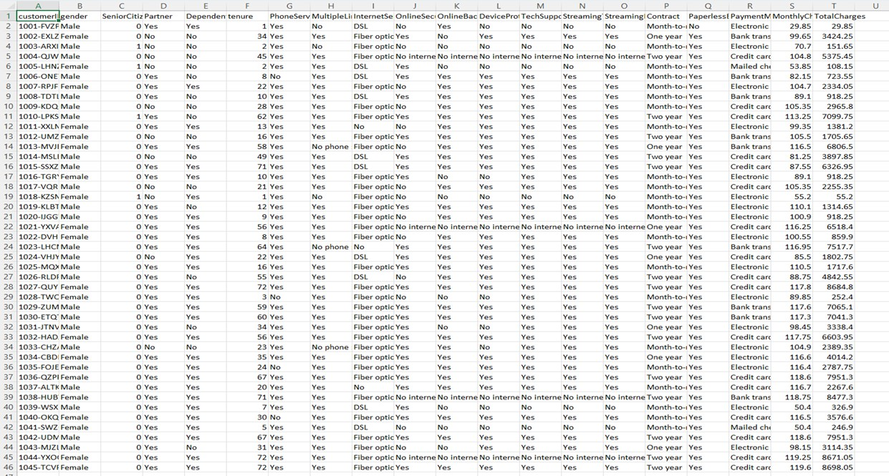




1
Gender
TELCO
DATASET
2
Age
3
Senior Citizen
4
Phone Service
5
Multiple Lines
6
Payment Mode
7
Contract Time Period

Slide 7


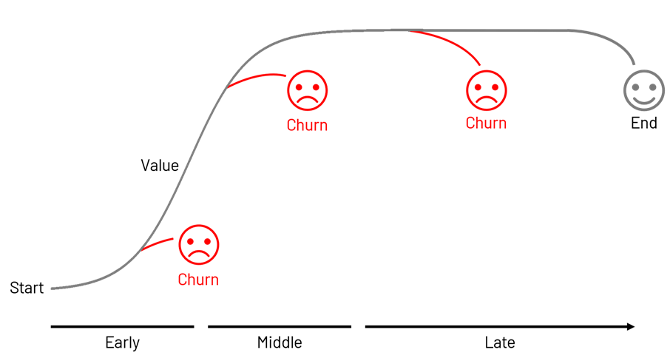
TELCO
Business Problem
Customer churn Prevention is the ultimate goal that enables customer retention and growth in revenue

Slide 8

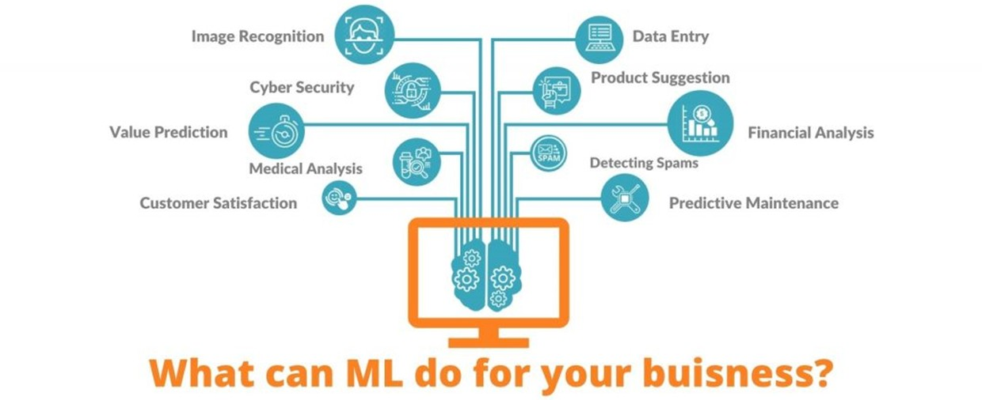

TELCO
APPROACH TO SOLVE USING ML MODELS
PATTERN IDENTIFICATION: THERE IS A PATTERN IN CUSTOMER BEHAVIOR THAT HAS TO BE IDENTIFIED
PREDICTIONS: WE CAN PREDICT THE CHURN RATE FOR A SET OF CUSTOMERS WITH GIVEN CONDITIONS AND IDENTIFY THE LAPSE

Slide 9
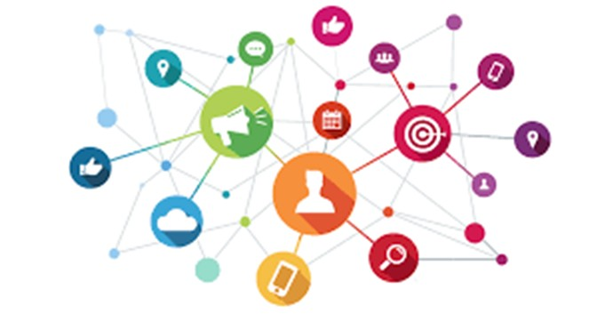

Implementation
TELCO
Churn can be prevented by giving undeniable offers based on the predictions made for each group of customers
Targeted marketing can be done based on observed customer behavior

Slide 10



Data Collection and Cleaning
Steps we have followed to wrangle the data
Data Cleaning
Data Transformation
Imputation
Data scaling and normalization
After performing the above steps we have taken sample data our for analysis and predictions

Slide 11
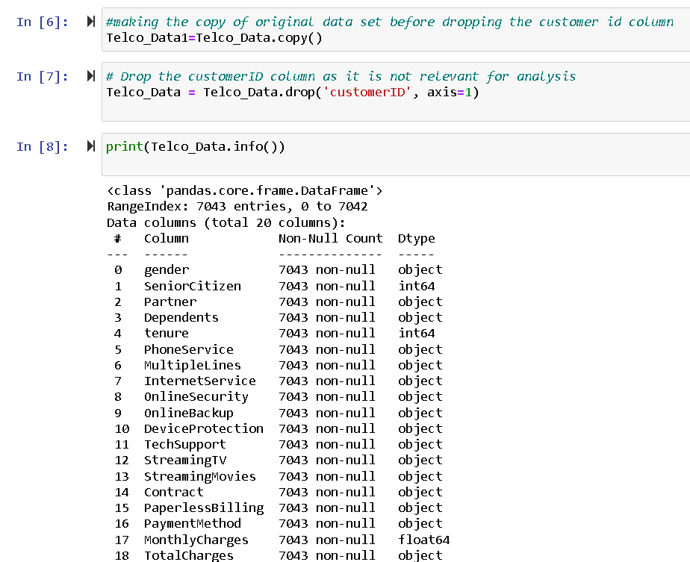
Data Cleaning :Removing irrelevant columns for data analysis from the data set

Slide 12

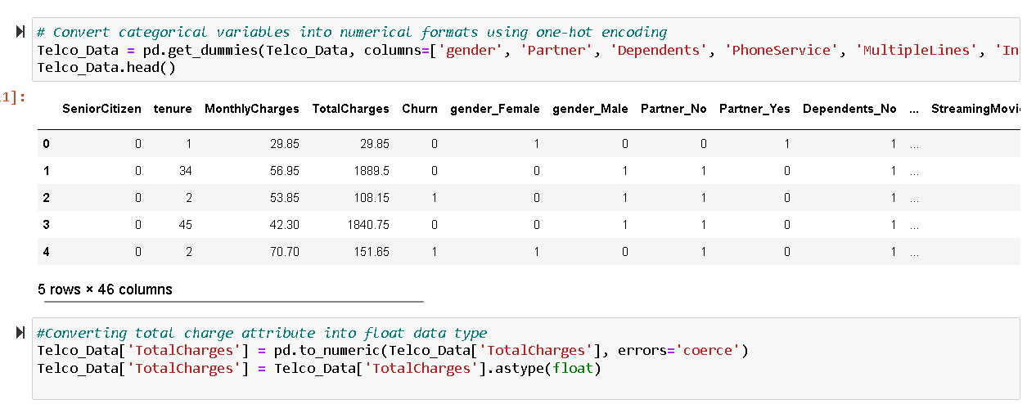
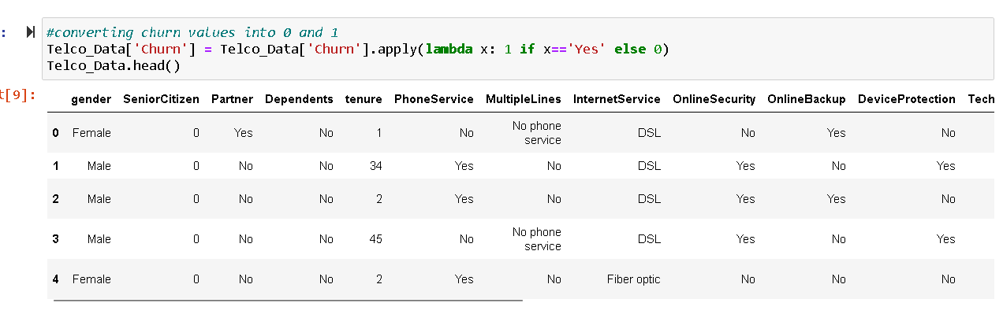
Data transformation using lambda and
one-hot encoding:

Slide 13
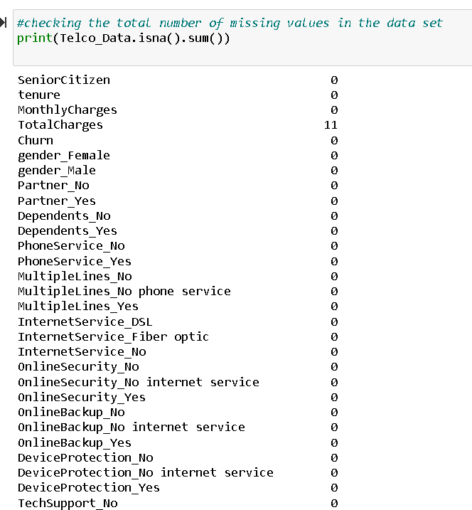
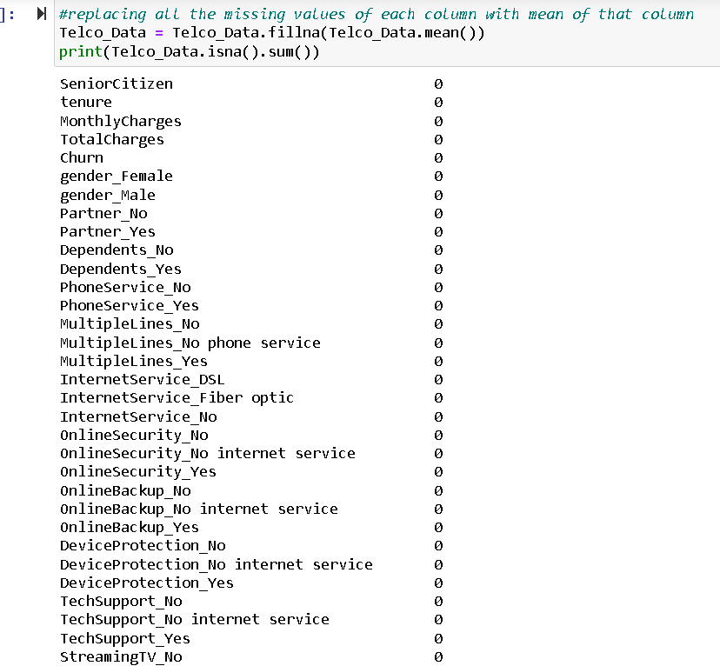
Imputation: By imputing all the missing
values with the mean value for each column.

Slide 14
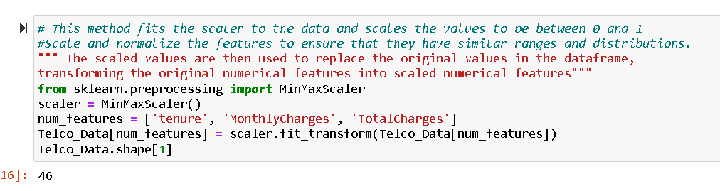
Scaling And normalization: Normalization using MinMaxScaler

Slide 15
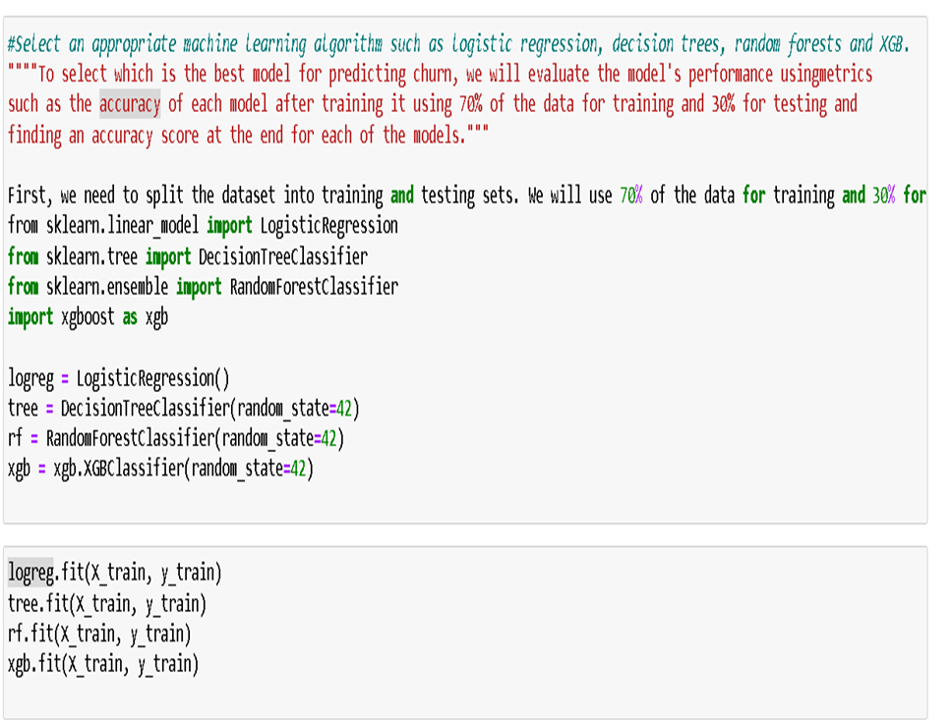
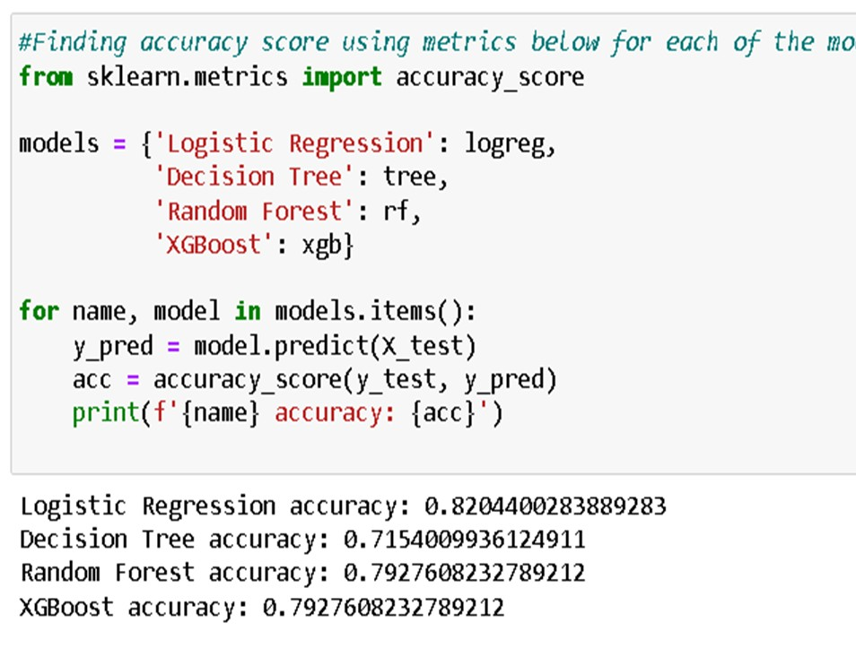
Model Selection : Choose a machine learning
algorithm that is suitable for the problem using accuracy score

Slide 16

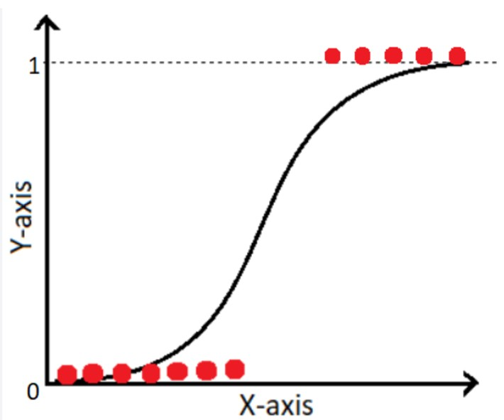
TELCO
Logistic Regression

Slide 17


Logistic Regression
TELCO
In this case, we're using logistic regression to model the relationship between customer characteristics and churn behavior
Our dataset includes features such as customer demographics, usage patterns, and account information
We can use logistic regression to identify the features that are most strongly associated with churn, and to understand how these features interact with each other

Slide 18


Logistic Regression
One benefit of logistic regression is that it provides interpretable coefficients that can help us understand the direction and magnitude of the relationships between features and outcomes
However, one challenge with logistic regression is that it assumes a linear relationship between the features and the log-odds of the outcome. If this assumption is not met, we may need to consider more complex modeling techniques
Once we've built a logistic regression model, we can use it to make predictions about whether a given customer is likely to churn. This can help us take proactive steps to prevent churn and improve customer retention

Slide 19
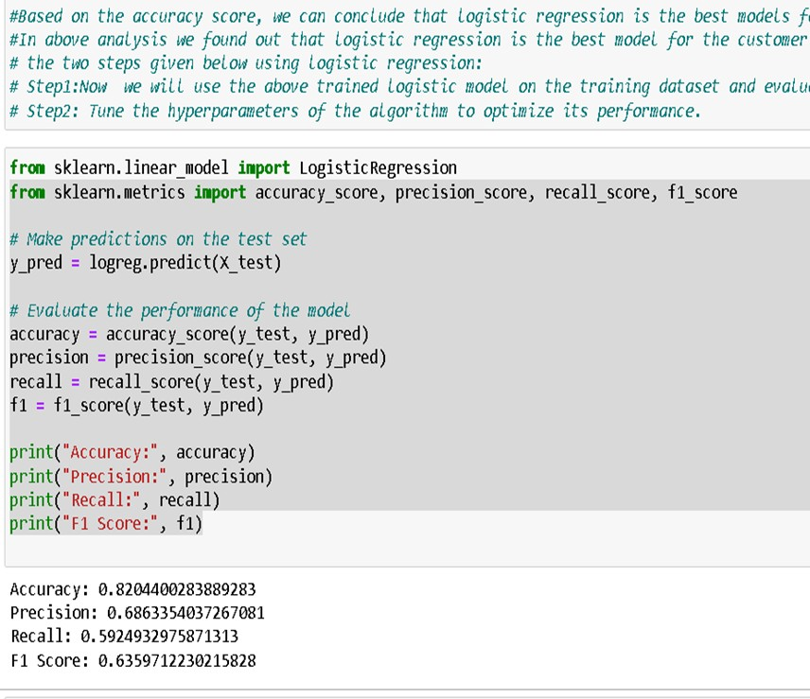
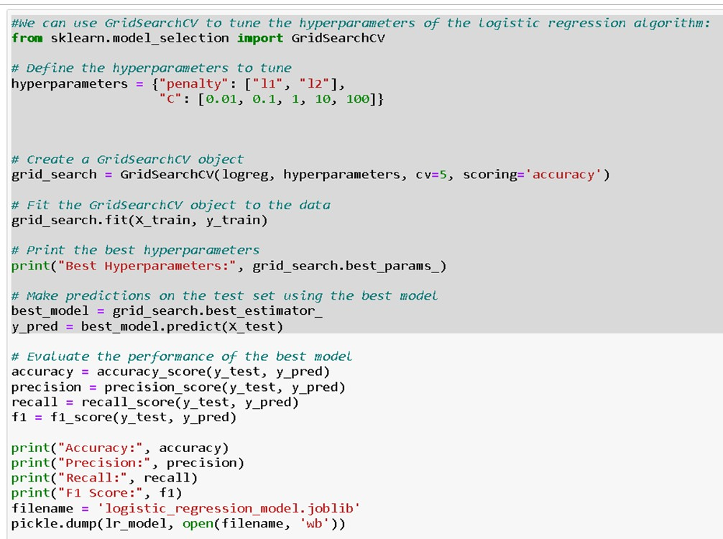
Model Development: Using logistic regression and tuning Hyperparmeters

Slide 20
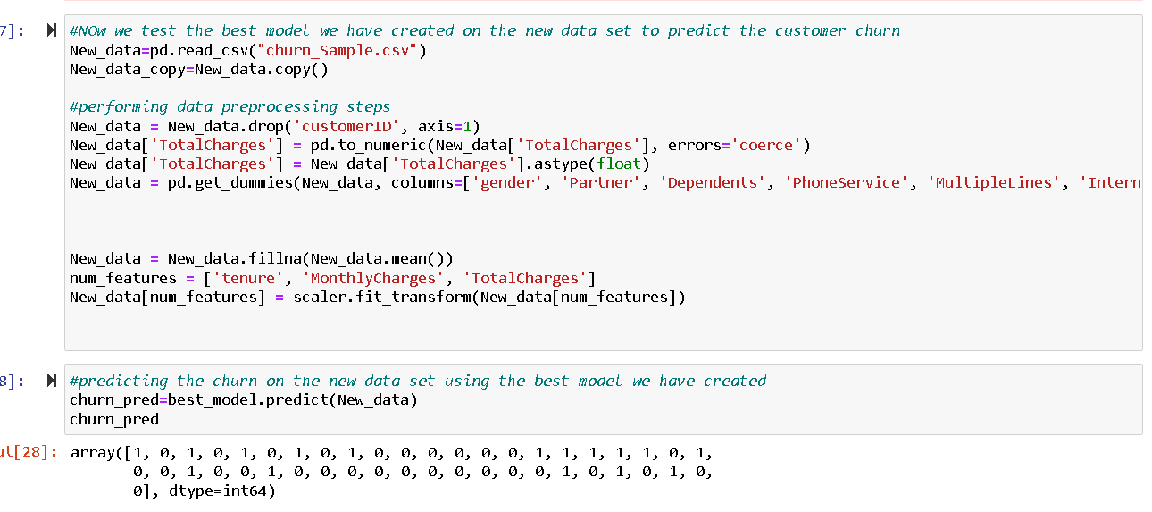
Predicting Churn: Using the best model we have created, we will predict churn for the new data set

Slide 21
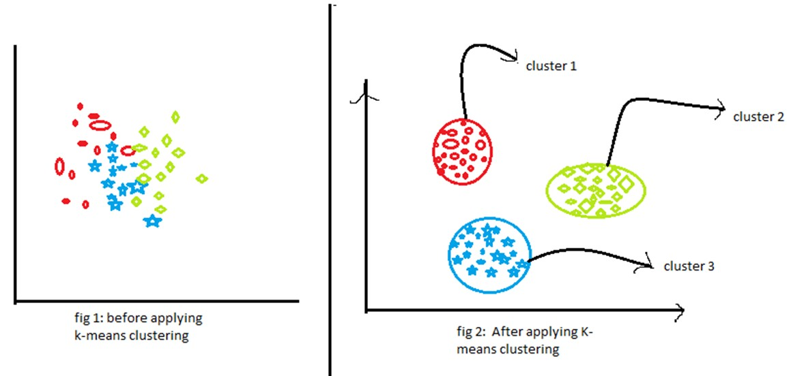
TELCO
K-means Clustering

Slide 22


K-means Clustering
TELCO
K-means clustering is a popular unsupervised learning technique used to group similar data points into clusters.
In this case, we're using k-means clustering to group customers
based on their churn behavior
Our dataset includes features such as customer demographics, usage patterns, and account information

Slide 23

We can use k-means clustering to identify groups of customers who are more likely to churn, and to understand the characteristics that define each group
TELCO
K-means Clustering
One challenge with k-means clustering is determining the optimal number of clusters to use. We can use techniques such as the elbow method or silhouette score to help with this decision
Once we've identified the clusters, we can use the insights gained to take action to reduce churn. For example, we might create targeted marketing campaigns or offer special promotions to customers in certain clusters

Slide 24
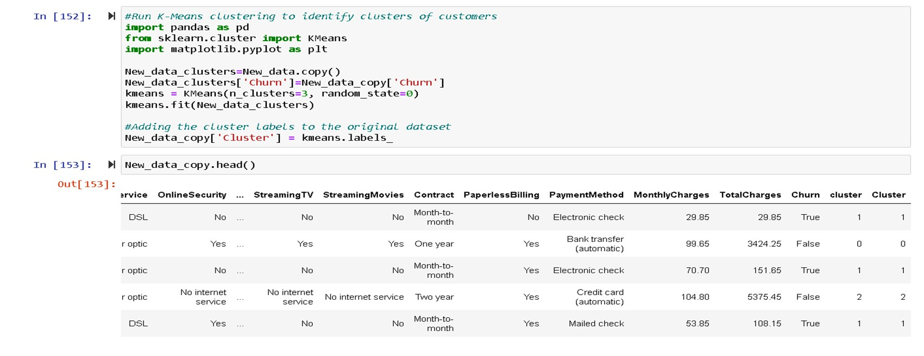
Applying K-Means Clustering on the churn data set

Slide 25
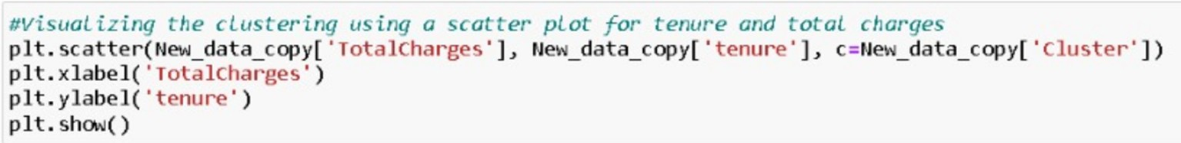
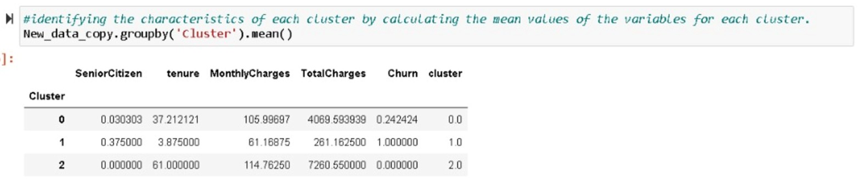
Output

Slide 26
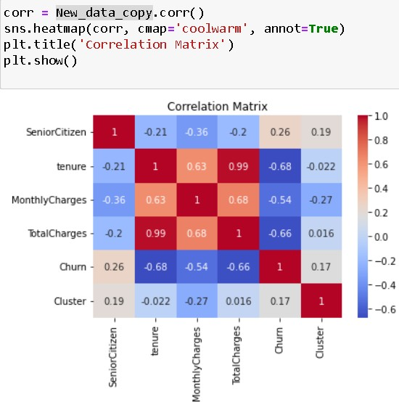
Heat Map:

Slide 27
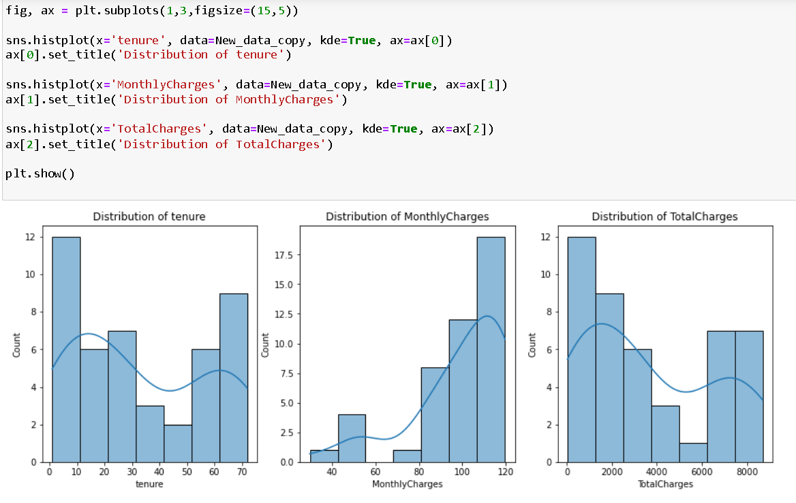
Distribution Curve:

Slide 28
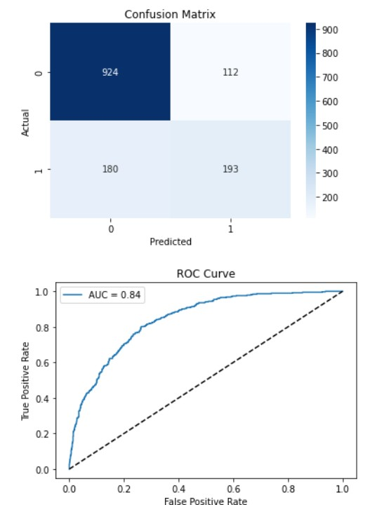
Confusion Matrix and Roc Curve :

Slide 29
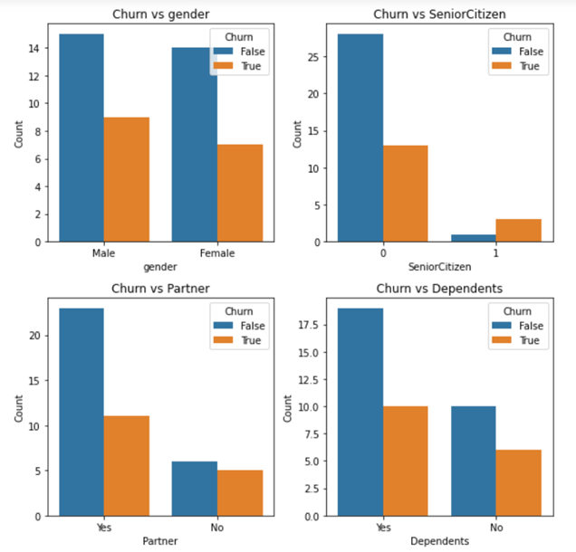
TELCO
Graphical Analysis

Slide 30

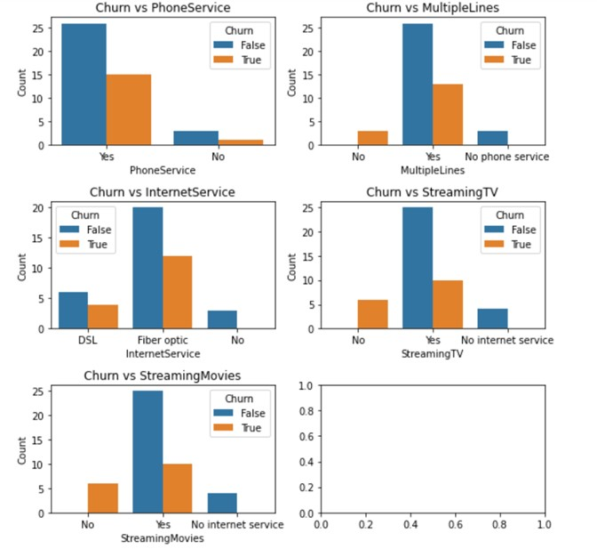
TELCO
Graphical Analysis

Slide 31
Insights
Confusion matrix shows that the model correctly predicted 1127 true positives (customers who churned) and 391 true negatives (customers who did not churn).
Negative correlation: between Tenure and Churn, which indicates that customers who have been with the telco service for longer are less likely to churn.
The histogram suggests that there is a large number of customers who have subscribed to the service for less than 10 months, and the number of customers decreases as the length of tenure increases.
Customers who have fiber optic internet service are more likely to churn than customers with DSL internet service.
Customers who have month-to-month contracts are more likely to churn than customers with one or two-year contracts.
Customers who pay higher monthly charges are more likely to churn than customers who pay lower monthly charges.

Slide 32

Takeways :
TELCO
Identification of customer behavior patterns and preferences that lead to churn across the three different customer segments
Segmentation of customers into three different groups based on their behavior and demographic data, allows companies to tailor retention strategies to each group.
Prediction of whether each customer in the different segments is likely to
churn or not using logistic regression, enables companies to take proactive measures to prevent churn.
Understanding of which factors have the most significant impact on churn within each customer segment and how they relate to each other.
Development of a data-driven approach to customer retention and experience
improvement, leading to increased customer satisfaction and loyalty across the three customer segments.

Slide 33

Thank You !!
By - Group 13

